Slide 1
Activity Logs for Altus
Altus is Ebay Inc’s Platform as a Service ( PaaS ) Solution.
Goal of this project is to display Altus logs to users for activities at the Application and at the asset level.
Reduce developer effort and turnaround time to search for logs on individual machines.
- Saurabh Chaure

Slide 2
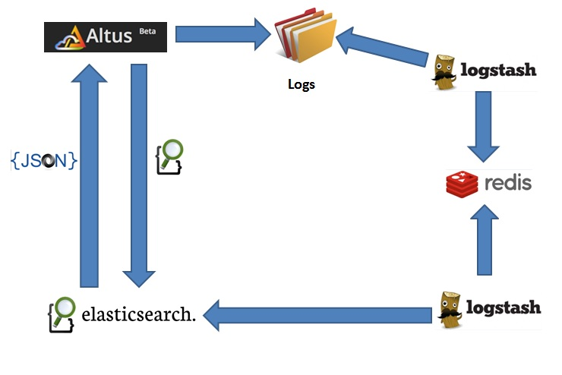
Activity Logs for Altus
Architecture Diagram

Slide 3
Challenges
Scalability
Robustness and Recovery
Performance tuning in Redis, ElasticSearch and LogStash

Slide 4
Next Steps
Streaming Logs for Individual Assets
Activity Logs for each actions performed
Expose relevant details to all Users

Slide 5
THANK YOU !
-Saurabh Chaure

